Slide 1
Pricing AI agents on Microsoft Foundry
PLAYBOOK · MICROSOFT FOUNDRY
How Foundry turns a pricing model into an architecture you can estimate, constrain, measure and prove.
TARGET MARGIN
COST CEILING
USE CASE
40%
$100 per request
Contract risk review
Notes:
This deck builds on the original "Monetizing AI Agents in Azure" playbook and focuses on one question: where does Microsoft Foundry help at each stage of pricing an AI agent? Note: Azure AI Foundry was renamed Microsoft Foundry at Ignite 2025.

Slide 2
Agent costs vary per request; your price has to stay predictable
01 · THE PROBLEM
What you charge
What you pay Azure
Fixed and easy for a CFO to budget
Variable and long-tailed per request
Base retainer
Prepaid credits
Per-outcome fees
Tokens for every agent step
Retrieval and tool calls
Evaluation runs and human review
Foundry's role in this playbook: make the right-hand side predictable, measurable and capped.
02 · Pricing AI agents on Microsoft Foundry
Notes:
Recap of the core problem from the original deck: flat subscription pricing breaks when a few heavy users drive most of the compute cost.

Slide 3
Contract risk review: work backward from value
02 · THE USE CASE
Input per request: 1 contract ≈ 5 pages and 50 risk checks.
VALUE
PRICE
COST SHARE
AZURE CEILING
$1,200
→
≈ $167
×
60%
=
$100
6 hours saved × $200/hr
≈14% of value captured [assumption]
Leaves a 40% gross margin
Max cost per contract
Corrected math: $167 × (1 − 0.40) ≈ $100. A 40% margin applies to the price, not to the $1,200 of value.
Validate the value-capture rate with customers first; every number downstream depends on it.
03 · Pricing AI agents on Microsoft Foundry
Notes:
The original deck subtracted a 40% margin from $1,200 of value and landed on $100, which doesn't work arithmetically. The missing step is value capture: what share of the value the customer will actually pay. At ~14% capture, price is ~$167, and 60% of that is the $100 Azure ceiling.

Slide 4
Foundry covers every stage of the pricing playbook
03 · WHERE FOUNDRY FITS
Stage | Foundry capability | What it does for pricing
Estimate | Model catalog + Azure Pricing Calculator | Cost per request before you write code
Build | Agent Service + Microsoft Agent Framework | A workflow you can cost step by step
Constrain | Model router (Cost, Balanced, Quality) | Cheap models on easy steps
Measure | Tracing in Application Insights | Token usage and cost per run and customer
Govern | Foundry Control Plane | Usage visibility and a request backstop
Prove | Evaluations + ROI view | Evidence for value or outcome pricing
The Foundry platform has no separate fee: you pay for the model calls, search, agent runtime and storage you consume.
04 · Pricing AI agents on Microsoft Foundry
Notes:
This is the map for the rest of the deck. Each row gets its own slide. Some features (monitoring dashboard, parts of model router) have been in preview; check current status before committing to them in production.

Slide 5

A multi-agent workflow you can price step by step
04 · BUILD
STEP 1
STEP 2
STEP 3
STEP 4
STEP 5
Intake
Clause agent
Risk agents
Reviewer agent
Human review
Document Intelligence extracts text and layout
Finds and labels each clause
Run 50 checks in parallel
Only for high-risk contracts
Consolidates findings and scores risk
Small model
Model router
People cost
OCR service
Frontier model
Microsoft Agent Framework patterns: sequential (steps 1→2→4), concurrent (step 3 fan-out), handoff (step 5).
Each agent runs in Foundry Agent Service, so each step's tokens show up as its own cost line.
05 · Pricing AI agents on Microsoft Foundry
Notes:
Microsoft Agent Framework unifies Semantic Kernel and AutoGen and ships stable orchestration patterns including sequential, concurrent, handoff and Magentic. Splitting the work into agents is what makes per-step pricing possible: you can give cheap steps cheap models.

Slide 6
Give each step the cheapest model that passes your evals
05 · CONSTRAIN COST
The Foundry model catalog offers models from OpenAI, Anthropic and other providers in one project, so one workflow can mix tiers.
Step | Model tier | Per contract
Intake | Document Intelligence | [$__]
Clause agent | Small model | [$__]
Risk agents ×50 | Model router | [$__]
Reviewer agent | Frontier model | [$__]
Evals + human review | Variance costs | [$__]
Total at P90 |  | ≤ $100
Compare quality against price in the catalog, then confirm on your own contracts.
Fill the bracketed figures from the Azure Pricing Calculator for your region.
06 · Pricing AI agents on Microsoft Foundry
Notes:
Use real model names and current prices from the Foundry catalog rather than placeholder names. The risk-check step runs 50 times per contract, so it dominates cost; that is where a small or routed model pays off most.

Slide 7
Model router chooses the model per request
05 · CONSTRAIN COST
One deployment; a trained router sends each prompt to a nano, standard or reasoning model based on difficulty.
Quality
Balanced (default)
Cost
Always the highest-quality model; cost ignored.
Weighs cost and quality for each prompt.
Accepts a ~5–6% quality band to pick cheaper models.
Before you rely on it
The router bills its own input tokens on top of the chosen model.
Context window equals the smallest model in the routing pool.
Benchmark on your own contracts before production traffic.
07 · Pricing AI agents on Microsoft Foundry
Notes:
Sources: Microsoft Learn model router docs and InfoQ (Aug 2026). Savings depend entirely on traffic mix; Microsoft publishes an open-source evaluation pipeline to measure quality, cost and latency together. Routing mode is set per deployment, so you can run a Cost-mode deployment for bulk risk checks and a Quality deployment for the reviewer.

Slide 8
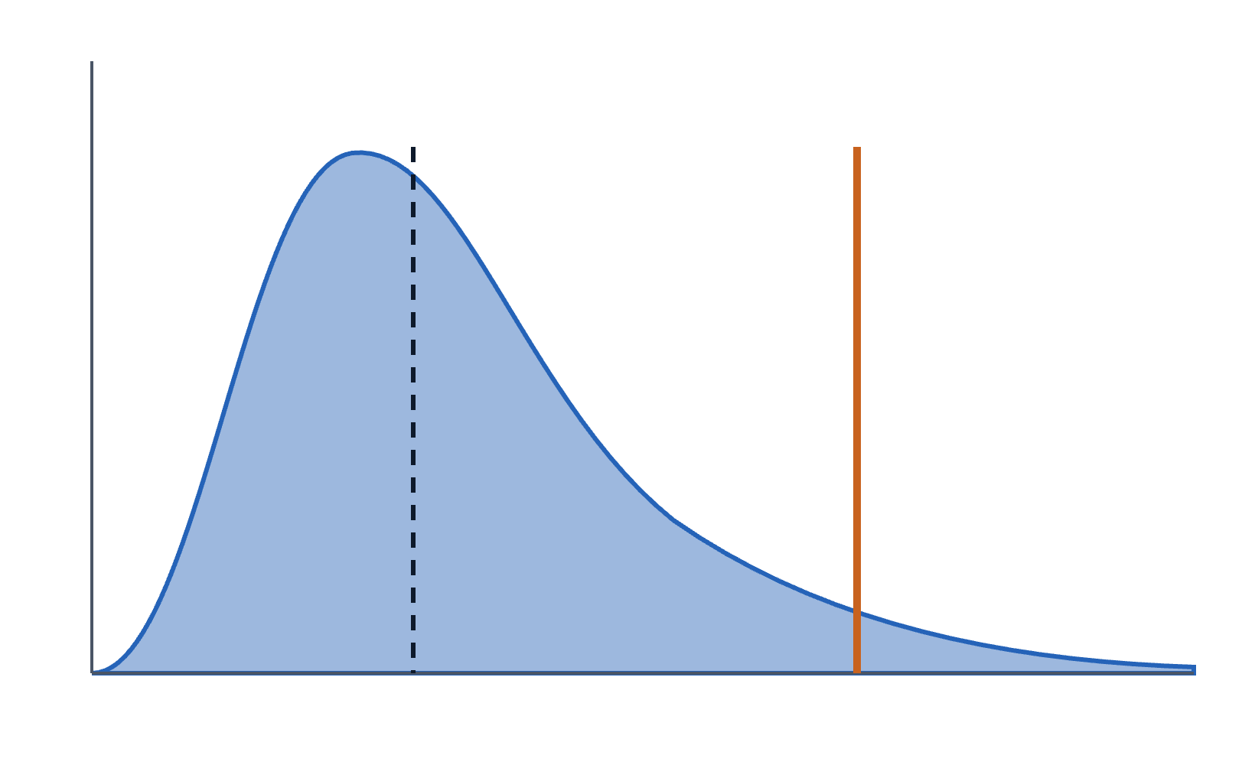
Set the cost ceiling at P90, not at the average
06 · MEASURE
01
Run a pilot batch of real contracts through the workflow in Foundry.
Median
P90 ceiling
02
Read token usage per run from Foundry tracing.
03
Take the P90 cost per contract as your ceiling input.
04
Project monthly spend in the Azure Pricing Calculator.
Long tail of costly contracts
Cost per contract →
08 · Pricing AI agents on Microsoft Foundry
Notes:
Unlike the bell curve in the original deck, agent cost per request is right-skewed: most requests are cheap and a few are very expensive. Pricing at the median or mean loses money on that tail; building the cost basis at P90 means most requests generate extra margin.

Slide 9
The pricing equation
07 · PRICE
Price = (P90 cost + variance costs) ÷ (1 − margin)
COST
PRICE
CREDITS
P90 run cost [$__] + evals and review [$__] ≤ $100
$100 ÷ 0.60 ≈ $167 per contract
1 contract = [5] credits ≈ $[33] per credit
Size the base retainer so ~80% of customers stay within their included credits; heavier users buy top-ups.
09 · Pricing AI agents on Microsoft Foundry
Notes:
This corrects the original equation, which added a percentage to dollar amounts. Dividing by (1 − margin) is the standard way to price at a target gross margin. The 80% retainer rule comes from the original deck's credit engine blueprint.

Slide 10




Tracing turns every run into a cost record
08 · MEASURE
Token usage and latency per span, sent via OpenTelemetry to Application Insights
Tag every run
Agent monitoring dashboard: token trends, success rates, eval scores
Tag | Example
customer_id | cust-4092
workflow | contract_review
agent_run_id | run-7f3a
credits_charged | 5
Alerts on token usage or latency spikes
Also traces agents built on other frameworks through the OTel exporter
Join tokens to tags in Kusto to see margin per customer and catch leaks early.
10 · Pricing AI agents on Microsoft Foundry
Notes:
Foundry stores traces in the Application Insights resource connected to the project, so retention, billing and access follow your existing Azure setup. The Agent Monitoring Dashboard has been in preview; check its status. Custom tags like customer_id are something you add in your own instrumentation.

Slide 11
Protect margin today, earn outcome pricing later
09 · GOVERN AND PROVE
Foundry Control Plane
Evaluations and ROI
Estimated token usage and cost per agent
Microsoft Entra identity per agent
Can block incoming requests when usage runs away
Continuous evaluations score production traces against your rubric
ROI view puts a value on the agent
Builds the reliability record outcome pricing needs
Start with credits; move toward per-outcome fees as evaluation scores prove autonomy.
11 · Pricing AI agents on Microsoft Foundry
Notes:
The original deck's roadblock slide said you can't price fully on outcomes without near-full autonomy. Foundry's evaluations and ROI tooling are how you build the evidence to get there gradually.

Slide 12
Four phases from estimate to optimized margin
10 · ROLLOUT
PHASE 1
PHASE 2
PHASE 3
PHASE 4
Estimate
Pilot
Launch
Optimize
Model the $100 ceiling in the Pricing Calculator
Shortlist a model for each step
Build the workflow in Agent Service
Run real contracts with tracing on
Measure P90 cost per contract
Set retainer and credit rate from P90
Tag runs with customer_id
Alert on token spikes
Tune model router modes
Run continuous evaluations
Revisit price as costs fall
12 · Pricing AI agents on Microsoft Foundry
Notes:
Phase lengths depend on your team; the order matters more than the timing. Don't set prices until the pilot gives you real P90 numbers.

Slide 13
Your architecture is your pricing strategy.
Microsoft Foundry is how you estimate it, cap it and prove it.
Next step: price one workflow end to end with real traces.

Slide 14
Presentation title
A one-line subtitle for the presentation.

